Slide 1

Airbnb New User Destination
LlanfairPG
Olivia, Nicola, Miguel, Manu, Alun

Slide 2
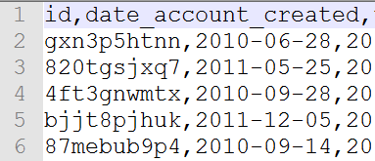
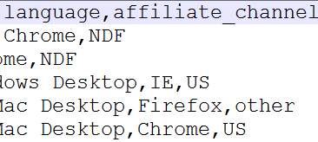
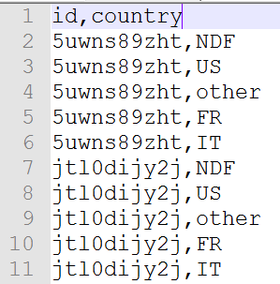
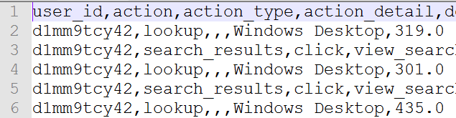
Competition and Dataset
New users
First booking
Predict from 10 possible destinations (out of 190+)
User Profile
Train
Test
Sessions
Submission sample

Slide 3
Feature Engineering
Data
Evaluation
Preprocessing
FE Process
New features
Clean Data
Feature Engineering

Slide 4
Feature Engineering
Users’
profiles
Users’
Sessions
Feature Egnineering (splitting, binning, combination, OHE)
Feature Egnineering (binning, OHE)
Users

Slide 5
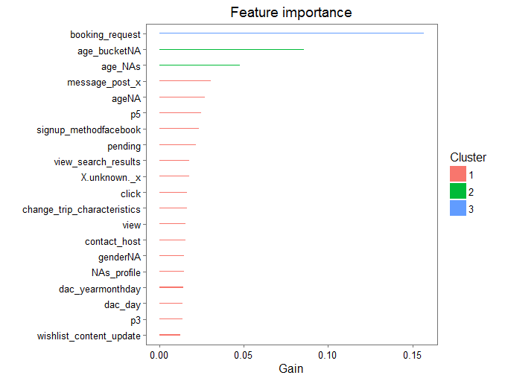
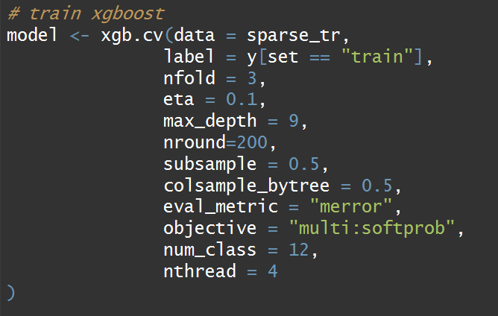
XGBoosting
XGB is an implementation of Gradient Boosting (decision tree ensemble)
Very fast
Decision trees are interpretable
Used to win the majority of Kaggle competitions.
There are many parameters to the model, cross validation was done to optimise these.

Slide 6
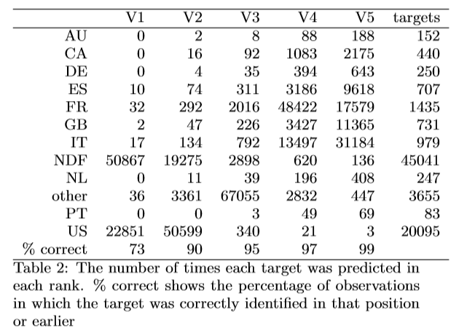
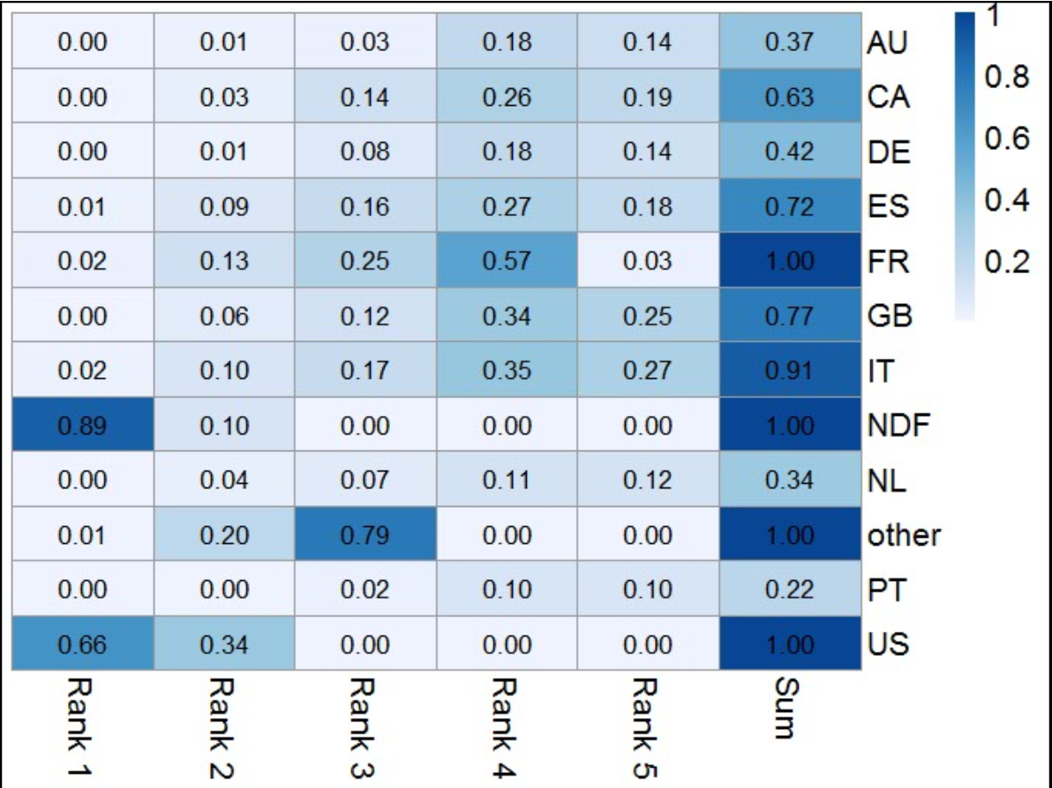
XGBoosting: Training set predictions
Accuracy of predictions in table 2.
Notes:
How to interpret graph
Null hypothesis
Accuracy when breaking away from null (breaks away from null more when model improves)
Low sample predictions
100% predictions

Slide 7
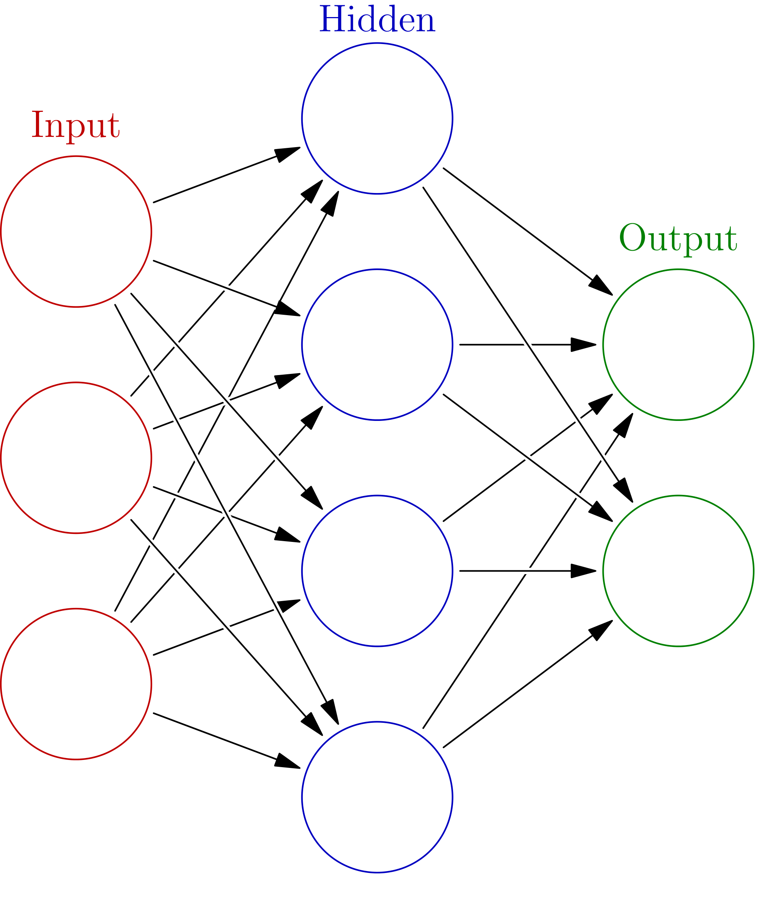
Artificial Neural Network
ANN for prediction
Training and Test set reduction
Libraries used: nnet and neuralnet
The learning algorithm:
SGD
The decay factor
Resilient SGD
Results:
Hidden layers an neurons, parameters.

Slide 8
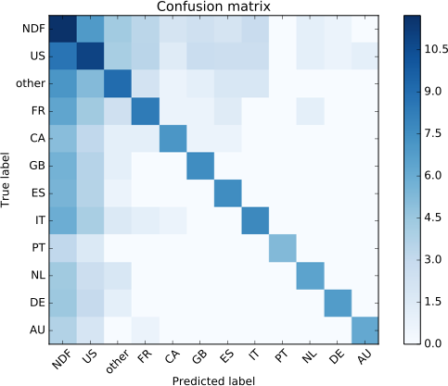
Random Forests
Log scale

Slide 9
Comparisons
 | NDCG
XGBoost | 0.8777
Neural Network | 0.8513
Random Forest | 0.8622
All NDF | 0.6841
NDF and US | 0.8307
XGBoost benchmark (basic feature engineering) | 0.8655
Null | 0.6854

Slide 10
Conclusions
Learners do not have confidence outside of the null hypothesis
Sessions data adds accuracy (two of the models)
Date fields have high importance
NA values in the age field has high importance in all models.

